Slide 1

Presentation on Rating Prediction Project
Presented by Chris Chhotai

Slide 2
AGENDA:
Overview.
Problem Statement.
Problem Understanding.
What is Rating Prediction?
Importance of Rating Prediction Project.
Data Analysis and Model Building Flow Chart.
Exploratory data analysis.
Visualizations.
Analysis.
Model Building.
Hyper Parameter Tunning.
Conclusion.

Slide 3
OVERVIEW:
In this particular presentation we will be looking on:
How to analyze the dataset of Rating Prediction Project.
What are the EDA steps in cleaning the dataset.
Overall analysis on the problem.
Model building from the cleaned dataset.
Saving the best model.

Slide 4

Problem Statement:
We have a client who runs a website where users may leave reviews for various technological products. They are now adding a new element to their website, requiring reviewers to include stars (ratings) with their reviews. The rating is out of five stars, and there are only five alternatives available. 1 star, 2 stars, 3 stars, 4 stars, and 5 stars are the different types of stars. They now seek to forecast ratings for reviews that were written in the past but have yet to be rated. As a result, we need to create an application that can anticipate the rating based on the review.

Slide 5
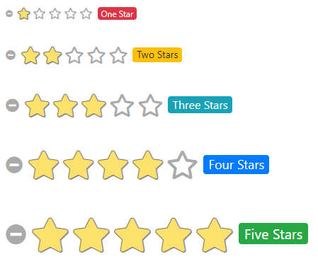
Problem Understanding:
Rating prediction is a well-known recommendation task that attempts to forecast a user's rating for goods that she has not yet evaluated. Users' explicit input, i.e., their past ratings on some goods, is used to calculate predictions. User reviews, which implicitly indicate consumers' thoughts on things, are another sort of feedback. Recent research suggests that inferred opinions from user evaluations on items are strong predictors of implicit feedback or even ratings from users, and hence should be used in computation.

Slide 6

What is RATING PREDICTION?
Rating prediction is a well-known recommendation task aiming to predict a user's rating for those items which were not rated yet by her. Predictions are computed from users' explicit feedback, i.e., their ratings provided on some items in the past.

Slide 7
Importance of Malignant Comment Classifier.
Customer reviews have become increasingly important as E-commerce has grown in popularity. There are hundreds of review sites online, and each product has many reviews. Buyers' buying habits have changed, and 70 percent of customers claim they use rating filters to filter out low-rated items in their searches, according to a recent survey. Companies that encourage reviews, such as Google, Amazon, and Yelp!, rely on their ability to determine if a review will be beneficial to other customers and so increase product exposure. There are two major approaches to this problem. The first is based on review text content analysis and employs natural language processing methods(the NLP method). This strategy lacks the information that can be gained from the customer-item relationship. The second is based on recommender systems, notably collaborative filtering, and is concerned with the reviewer's perspective.

Slide 8
Data Analysis and Model Building Flowchart
Import Libraries
Import Dataset
Visualizations
(EDA)
Data Balancing
TF-IDF Vectorizer
NLTK Text Pre-Processing
Model Building
Hyper Parameter Tuning
Saving the model

Slide 9
Exploratory Data Analysis:
Importing necessary libraries and loading dataset as a data frame.
Checked some statistical information like shape, number of unique values present, info, null values, value counts etc.
Checked for null values and I replaced those null values using imputation method. And removed Unnamed: 0.
Done text pre-processing techniques like Removing Punctuations and other special characters, Removing Stop Words, Stemming and Lemmatization.
After getting a cleaned data used TF-IDF vectorizer. It’ll help to transform the text data to feature vector which can be used as input in our 6 modelling. It is a common algorithm to transform text into numbers. It measures the originality of a word by comparing the frequency of appearance of a word in a document with the number of documents the words appear in. Mathematically, TF-IDF = TF(t*d)*IDF(t,d)

Slide 10
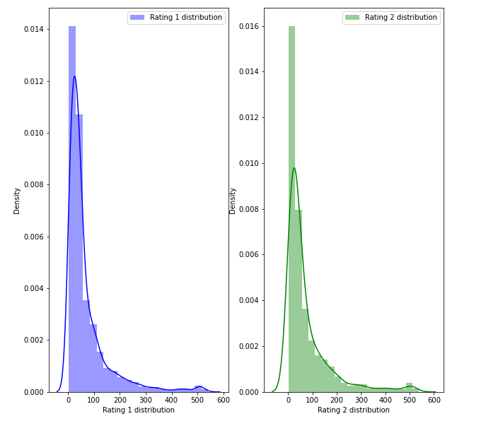
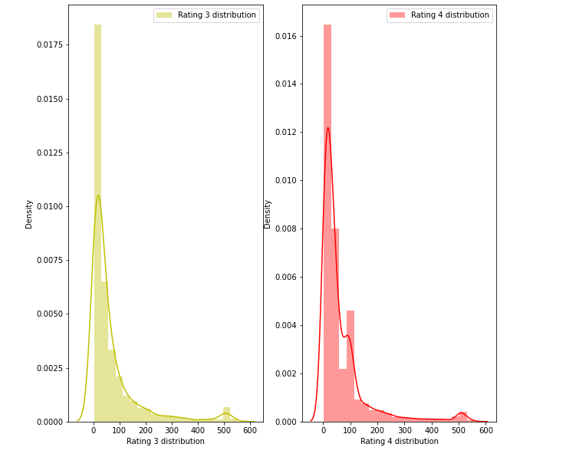
Visualization:

Slide 11
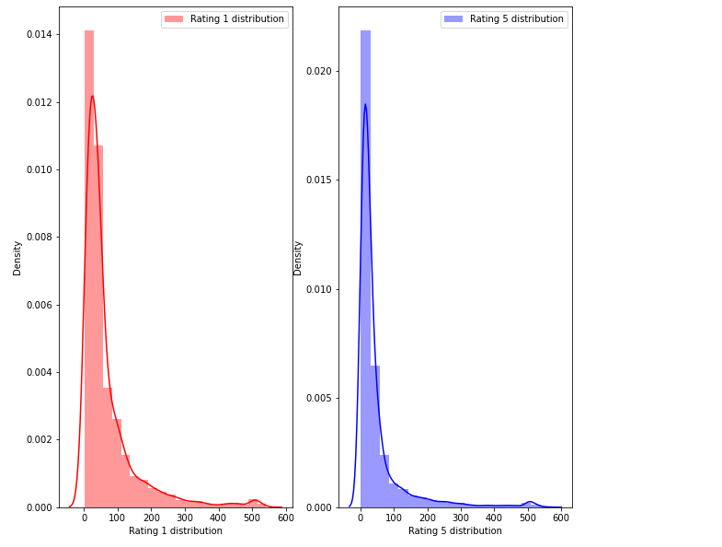
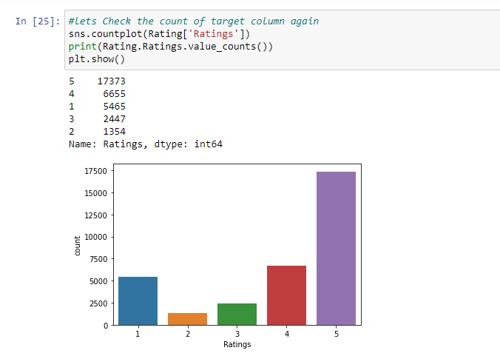
Visualization:

Slide 12
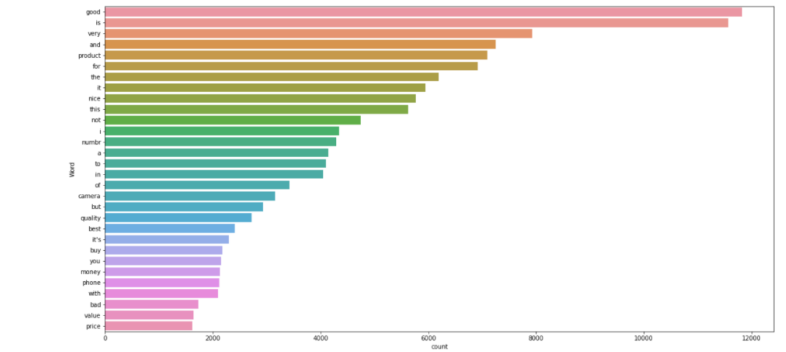
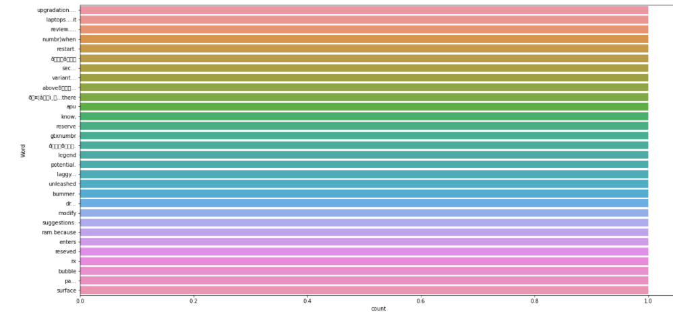
Visualization:
Most Repeated Words
Rare Words

Slide 13
Model Building:
In this nlp based project we need to predict ratings which are multiclassifiers. I have converted the text into vectors using TFIDF vectorizer and separated our feature and labels then build the model using One Vs Rest Classifier. Among all the algorithms which I have used for this purpose I have chosen SGDClassifier as best suitable algorithm for our final model as it is performing well compared to other algorithms while evaluating with different metrics I have used following algorithms and evaluated them
Kneighnors Classifier
DecisionTree Classifier
RandomForest Classifier
AdaBoost Classifier
MultinomialNB
GradientBoosting Classifier
Bagging Classifier
ExtraTrees Classifier
From all of these above models RandomForest Classifier was giving good performance.

Slide 14
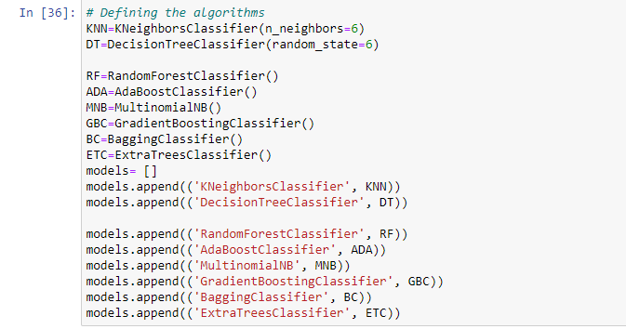
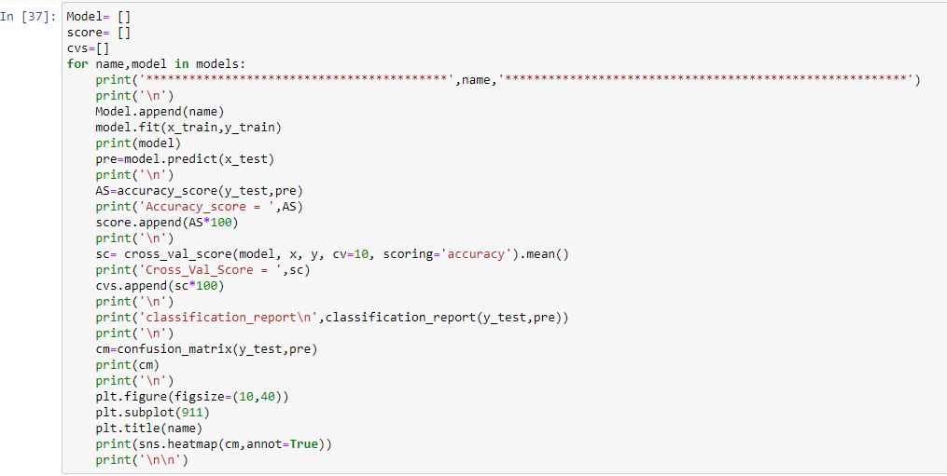

Slide 15
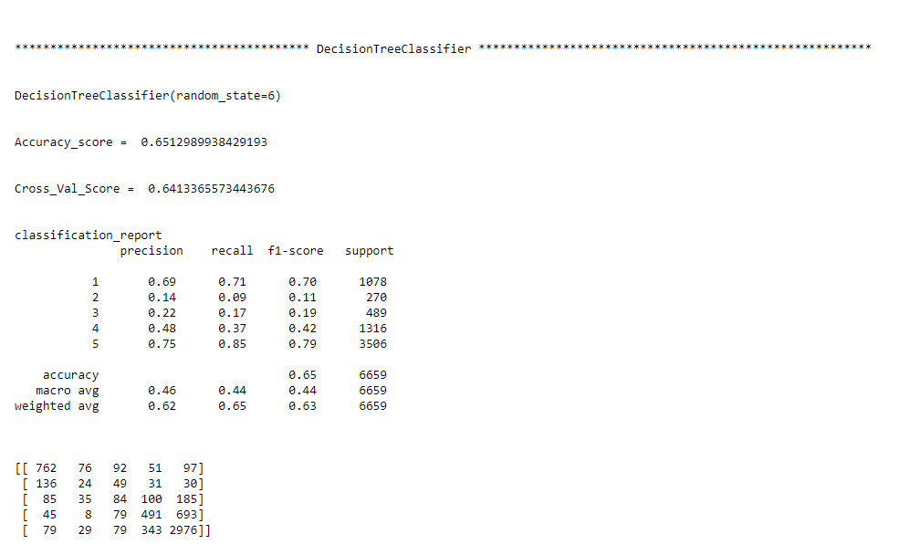
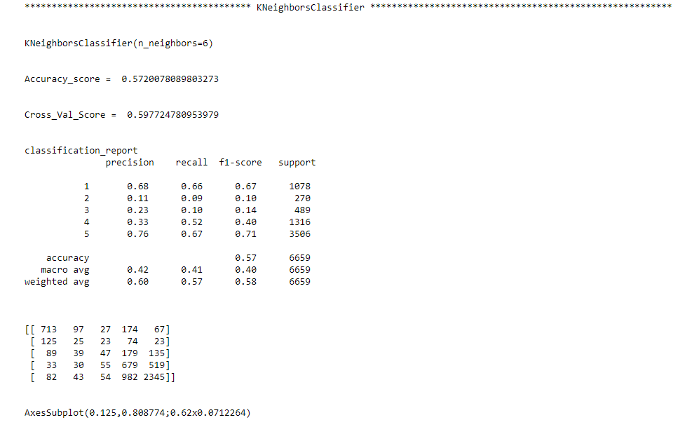

Slide 16
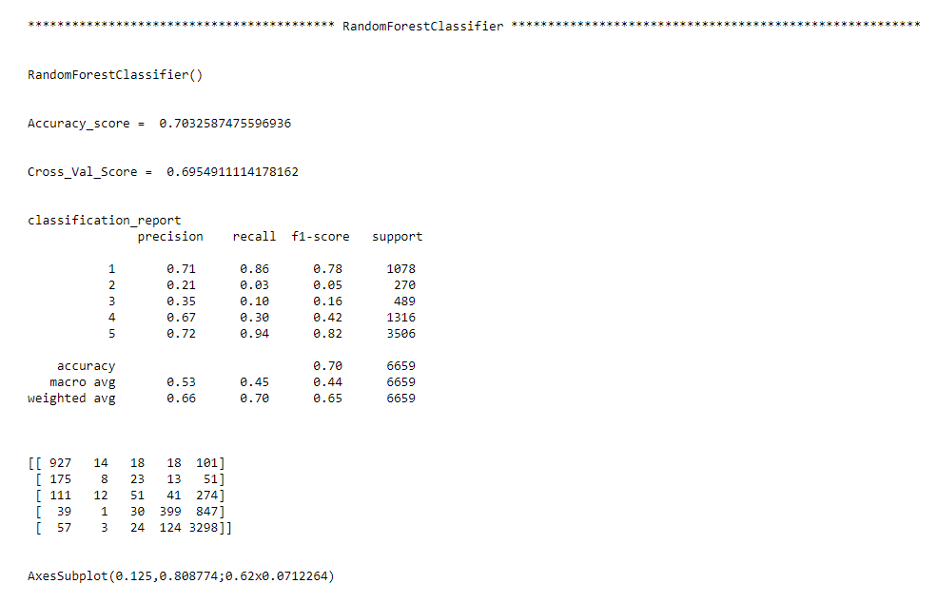
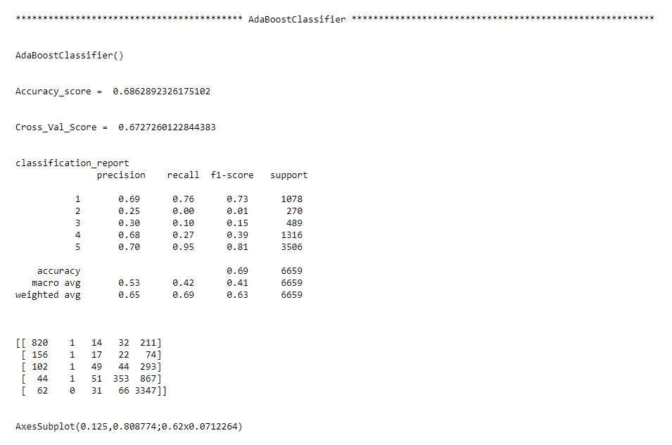

Slide 17
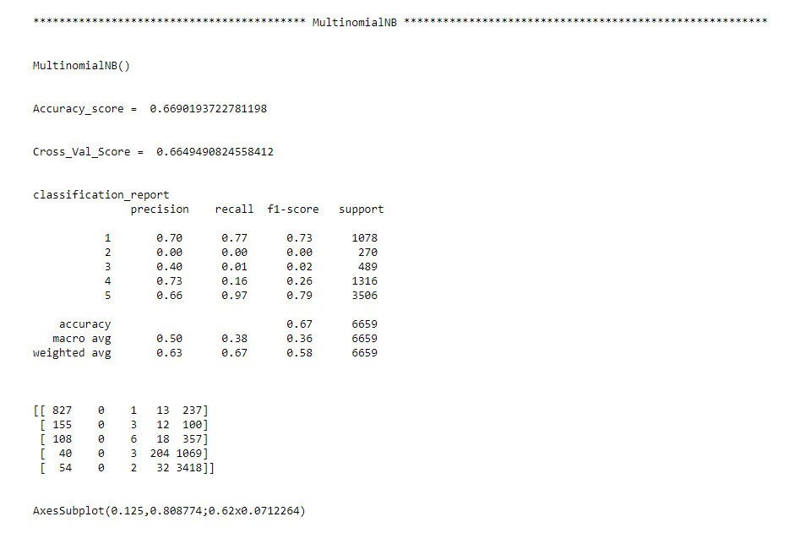
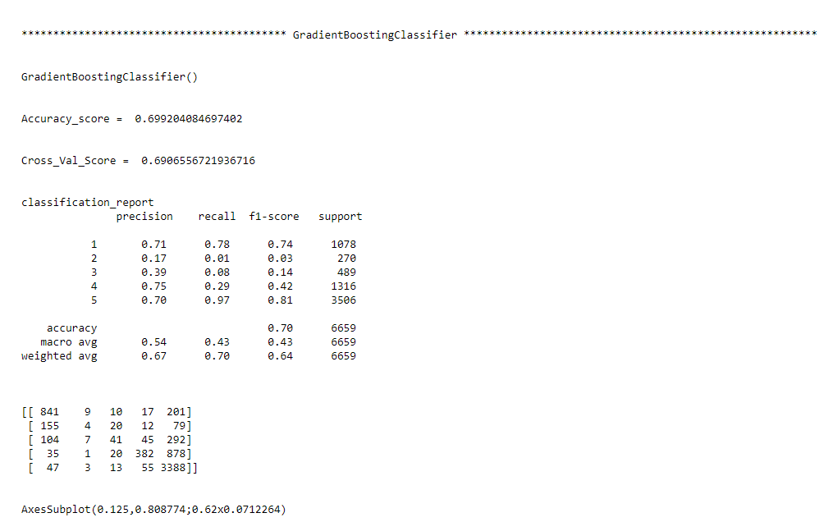

Slide 18
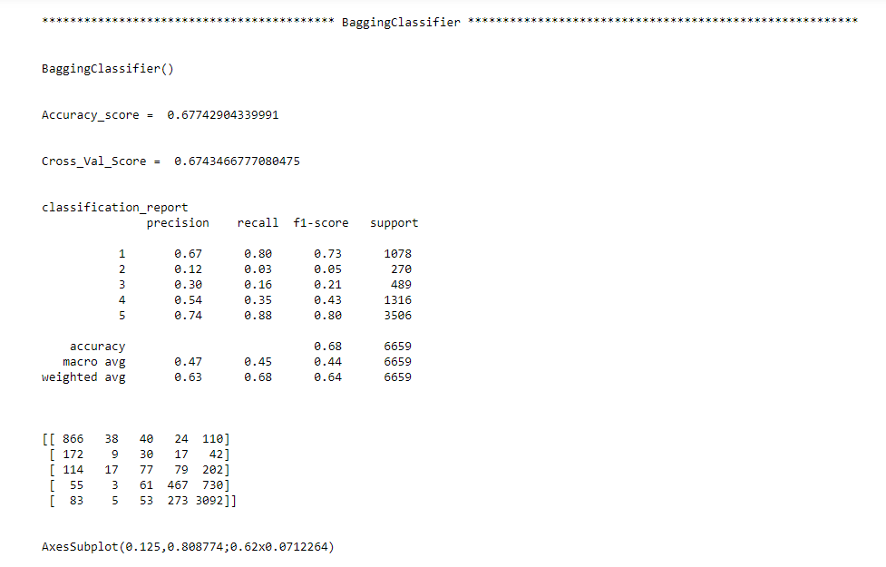
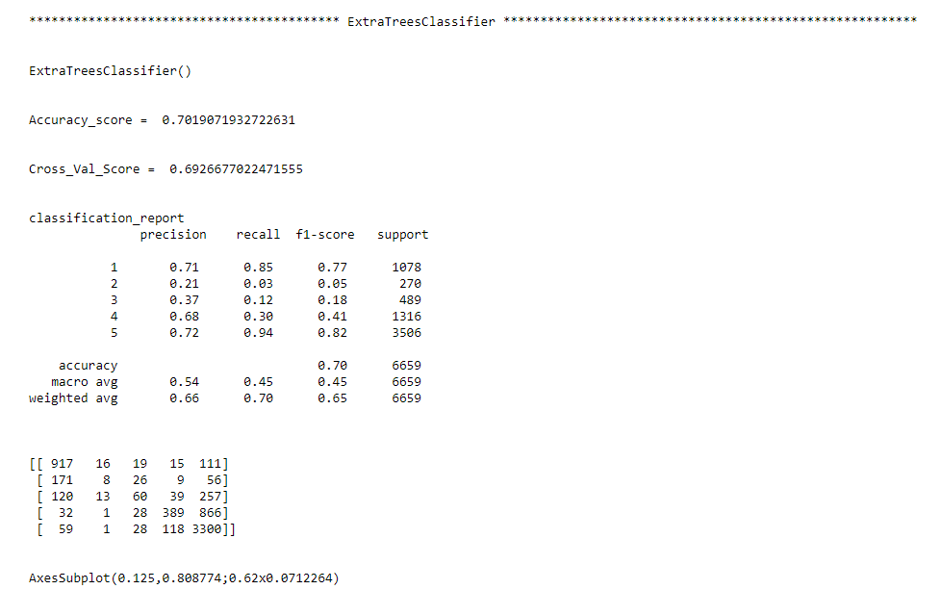

Slide 19
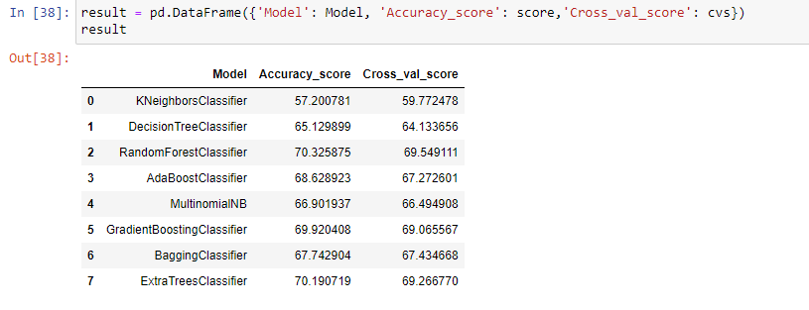

Slide 20
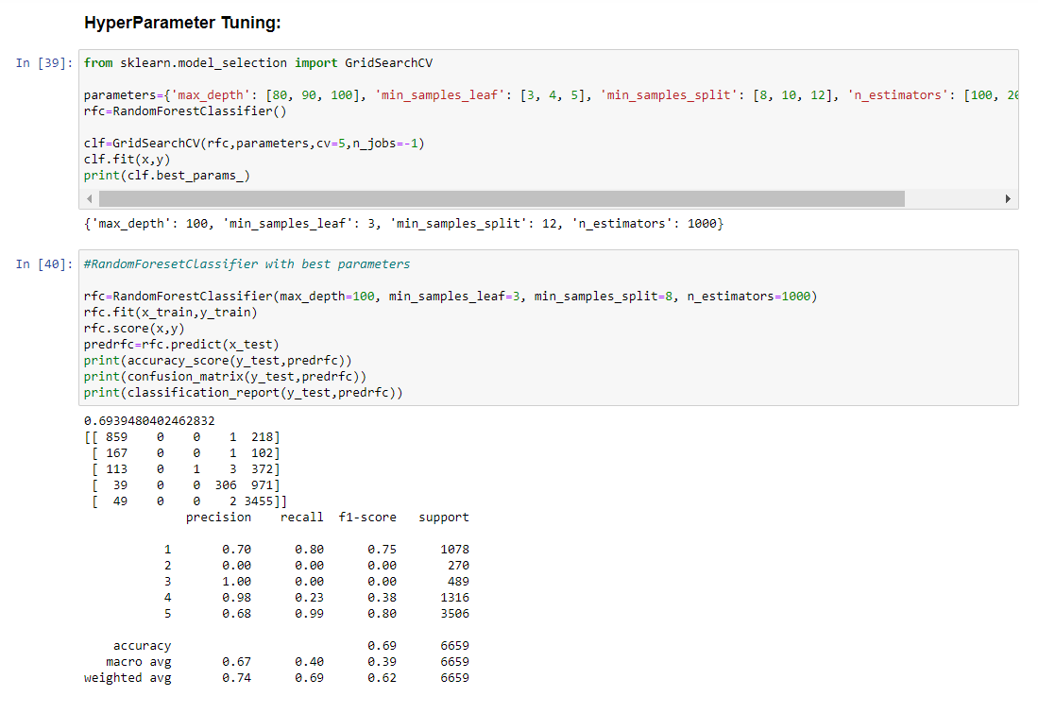
Hyper Parameter Tunning:

Slide 21
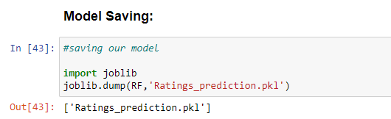
After training and building our final model I saved this model into .pkl file.

Slide 22

Conclusion:
In this study, we attempted to recognize ratings on a range of 1 to 5 in commercial websites based on user reviews. In order to accomplish so, we used natural language processing and machine learning methods. We deduced that the Random Forest Classifier Model produces the best results.
Learning Outcomes of the Study in respect of Data Science:
Data cleaning was a very important step in removing null values from the dataset.
Data visualisation assisted in identifying the label column's class composition as well as the most often appearing words in reviews related to each of the rating scores.
Different efficient ways for processing textual data were brought to light during the project's various data pre-processing and feature engineering processes. The NLTK package comes in handy when it comes to pre-processing text-based data and creating classification models.
Limitations of this work and Scope for Future Work:
The lack of a large dataset to work with made developing highly accurate models difficult. More accurate and economical classification models can be constructed by training the models on more diversified data sets, lengthier comments, and a more balanced dataset.

Slide 23

Thank You

